Slide 1
Graphics and Computational
Programming

Slide 2
Introduction
What is PBR:
‘Physical Based Rendering’ is the study and implementation of real time computer graphics designed to resemble real world phenomenon.

Slide 3
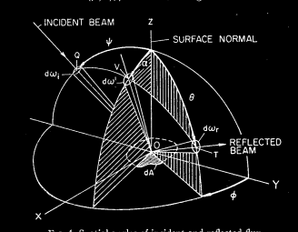
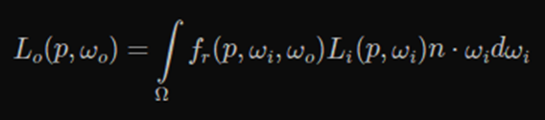
Theory
Irradiance and Radiance:
Though there are many implementations of PBR mostly all are based on the implementation of the ‘irradiance’ equitation, this is used to calculate the total light energy hitting a specific point in space – located at the position of the shaders fragment in our case. Irradiance is calculated using the integral below, this sums up all light energy passing through infinitesimally small regions around the position from the infinitely many different directions. The quantity of energy hitting an singular area of space from a given direction is called a directions ‘radiance’.
The equation actually gives us one of these radiances in the form of light bouncing away from the point and towards the observer.
Radiance:
from point to source
Radiance:
from point to observer
BDRF:
Bidirectional Reflectance Distribution Function
Light • Surface Normal

Slide 4
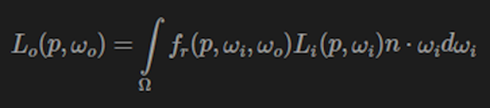
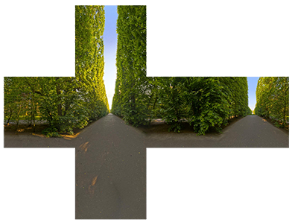

Theory
IBL:
‘Image Based Lighting’ uses cube map textures to act as pre-baked lighting across the scene, these cube maps are then convoluted to average out the amount of light coming from specific regions. The scene lighting then uses these maps by taking discrete samples around a hemisphere above the points normal and summing up there values populating the integral. The benefit of using prebaked cube maps mean that the light reflected from a materials surface can easily return that of the true light colour data from around the scene, resulting in more realistic reflections.
Simple Lighting:
A different approach is to instead work with the point lights in the scene directly, taking the radiance to the point from each of these lights and summing just there values, this comes with the assumption that all other points of radiance around the scene are equal to exactly zero. This can still give some good results, however it’s somewhat unrealistic any reflected’ light will not be able to carry the true reflected colour of the scene.
Scene Cube Map
https://www.indiedb.com/features/using-image-based-lighting-ibl
Convoluted Cube Map
https://www.indiedb.com/features/using-image-based-lighting-ibl

Slide 5
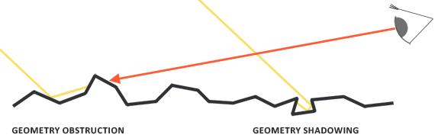
Theory
BRDF Functions:
A large part of the Irradiance equation is the BRDF function, the focus of this part of the equation is to let the material’s surface properties define how the light behaves on impact. While keeping conservation of energy the function distributes light into its diffuse and specular components based on its surface roughness (its microfacet’s) and whether the material is a ‘conductor’ or a ‘dielectric’, these two properties allow for a material to absorb and reflect light in unique ways.
Specular Light:
Specular lighting is made up of 3 components: The ‘Distribution’ function, ‘Geometry’ function and the ‘Fresnel’ function. These dictate how light is reflected on the surface of a material, the distribution function determines the average deviation all microfacets have to the surface normal. The geometry function defines how much of the light is blocked by micro-peaks (geometry obstruction) and micro-troughs (geometry shadowing) across the materials surface. A the Fresnel function determines how much light is reflected based on the steepness of the viewing angle from the observer to the objects.

Slide 6
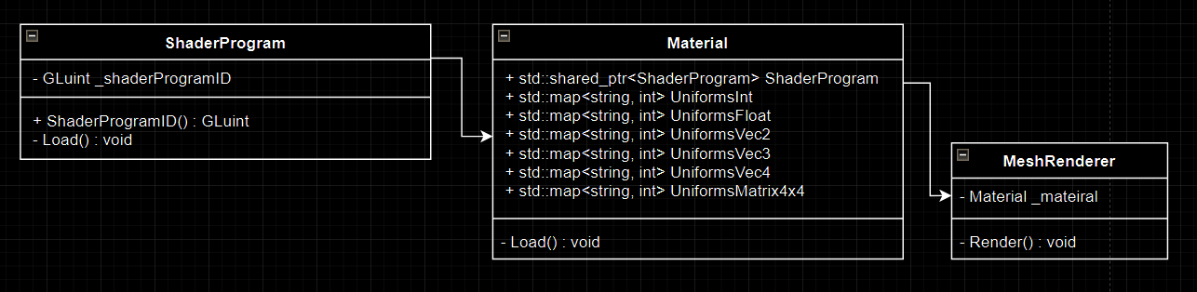
Design
Material to Shader:
The program I am creating these shaders to run on is specifically designed for easy shader and material development, this is done by allowing any uniform or attribute to be created and passed into the shader automatically through the use of dictionary's.
Materials and there associated shaders are loaded in and applied to the ‘MeshRenderer’ components attached objects, the materials are read as JSON files, this allows us to easily add new properties – like ‘in_Roughness’ – to the file and have a shader access them instantly for use.

Slide 7
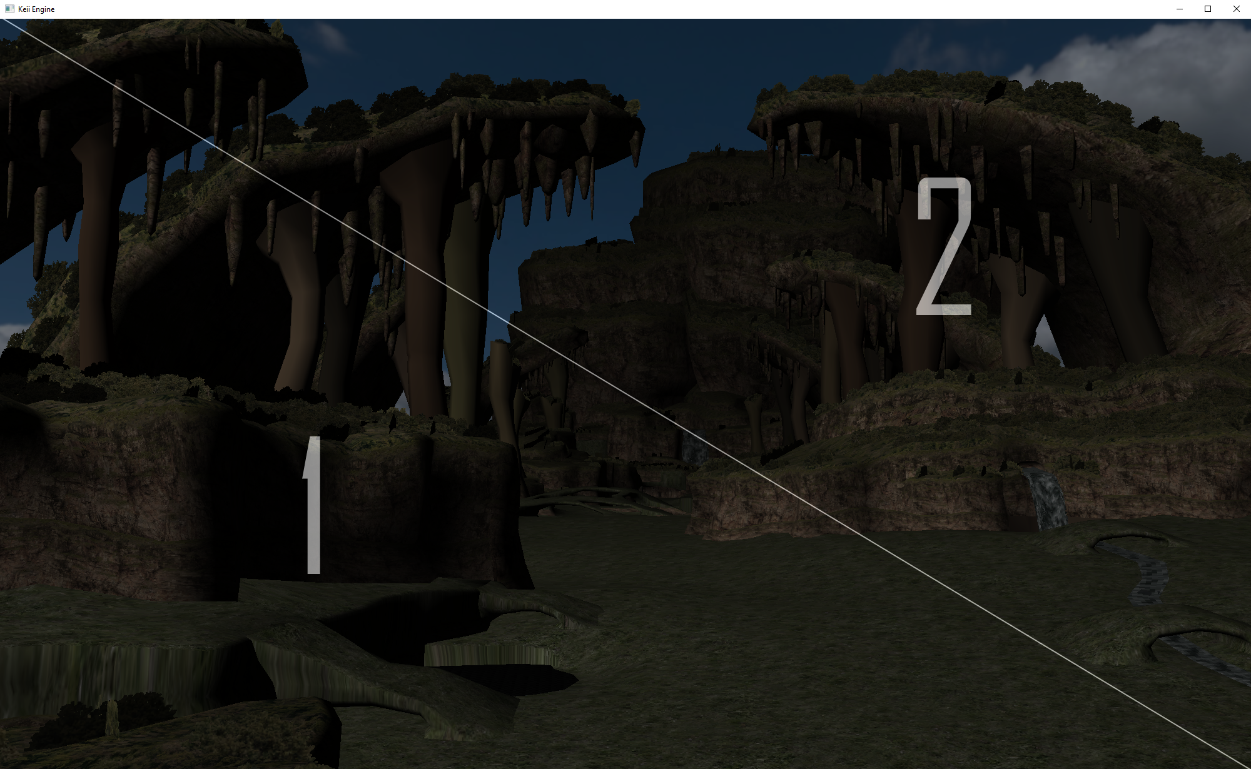
Design
Renderer:
Rendering uses the double buffering approach, the whole screen is rendered as a texture on the GPU, and then re-rendered to a single quad on the screen. This approach was adopted to solve issues with Z-Fighting across different hardware and also allow for the use of post-processing shaders.
Shaders:
The shader program is a combined file containing both the vertex shader and the fragment shader. These two shaders are separated by a #ifdef, for both “VERTEX_SHADER” and “FRAGMENT_SHADER” this allows for a single file to be read in a split into the desired shader program by appending either “#define VERTEX_SHADER” or “#define FRAGMENT_SHADER” to content string.

Slide 8
Demo

Slide 9
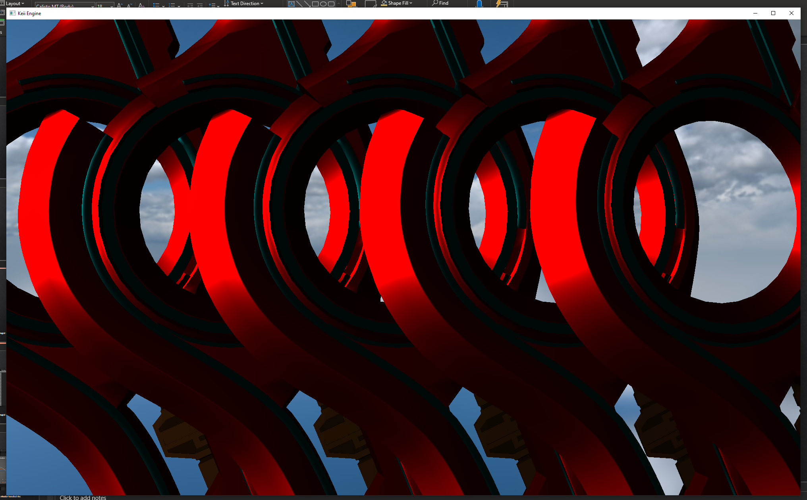
Quantitative Analysis
The Quantitative Test:
I will be analysing the differences across 3 shaders, this will consist specifying a number of lights - from 1 to 13 - in the scene, launching the application and averaging the frame data for each shader.
The shaders I will be testing will be:
A phong shader (Non PBR)
The LearnOpenGL PBR shader
A custom shader implementing the Torrance-Sparrow model for Specular Lighting, and the Oren-Nayar diffuse model.
Though the test has issues with the models intersecting, I chose this as a good way of filling the screen with different object using the same shader. Allowing me to test for a frame reasonable difference with the results of the shader.

Slide 10
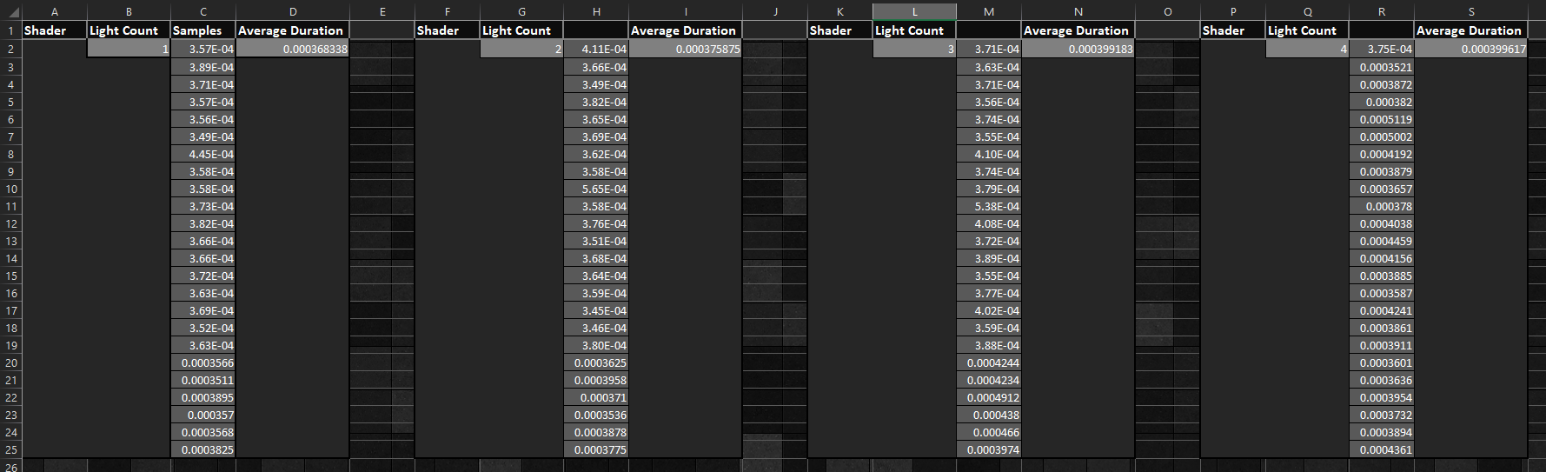
Quantitative Analysis
Each shader was tested over the course of several frame. This data was averaged and stored for each count of lights – from 1 to 13.

Slide 11
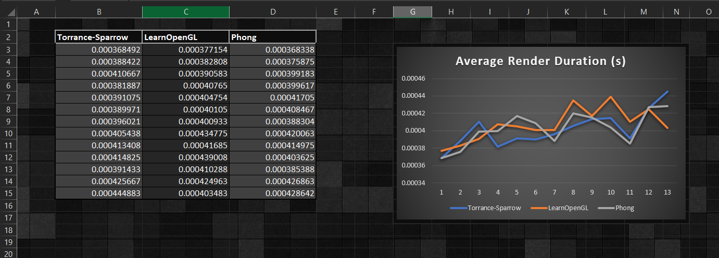
Quantitative Analysis
Once all averages where calculated a graph was created, showing how each shader handled the multiple light sources.

Slide 12
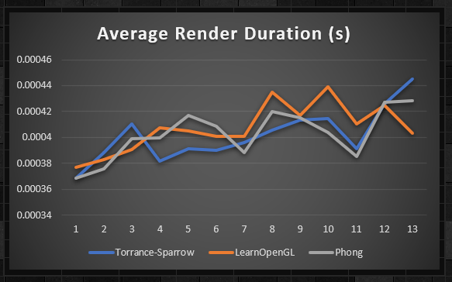
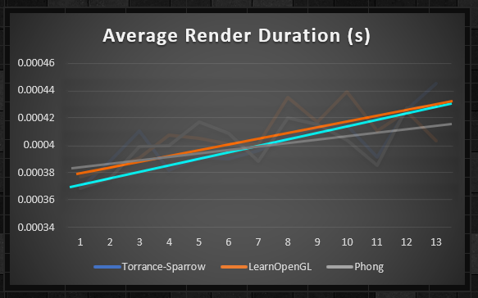
Quantitative Analysis
Though the results where a bit unpredictable, a trend did appear to form – The Torrance-Sparrow model appeared to start of better however appeared like it would perform the worst with more lights. While the simple Phong shader appeared the most erratic, it didn’t appear to trend upwards as steeply as the two other PBR shaders – somewhat unsurprisingly.

Slide 13
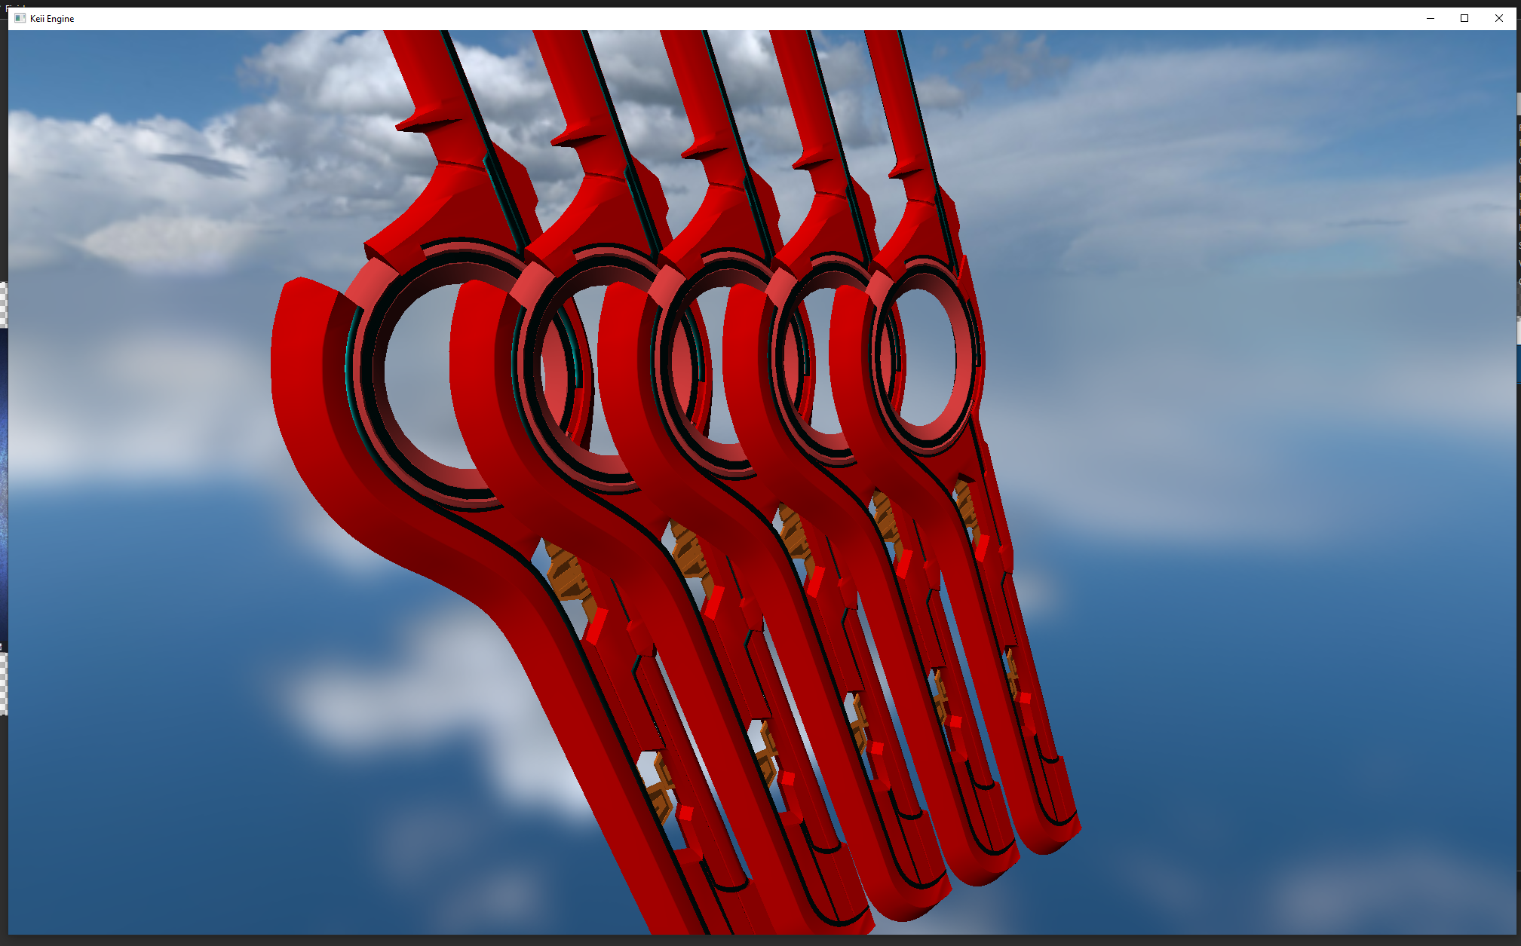
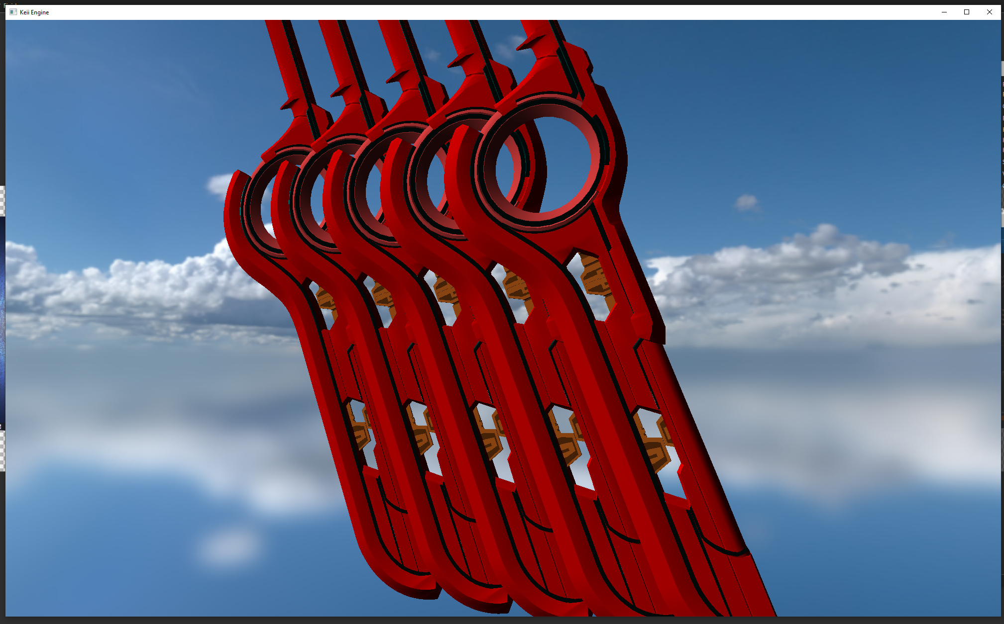
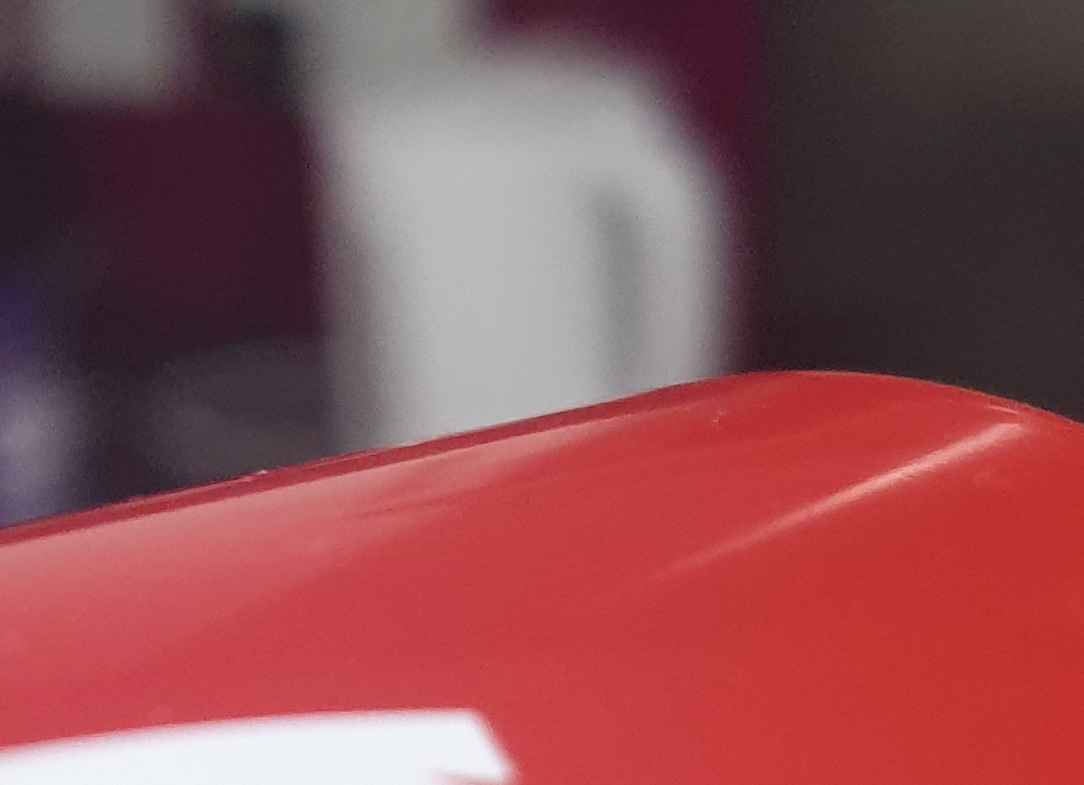
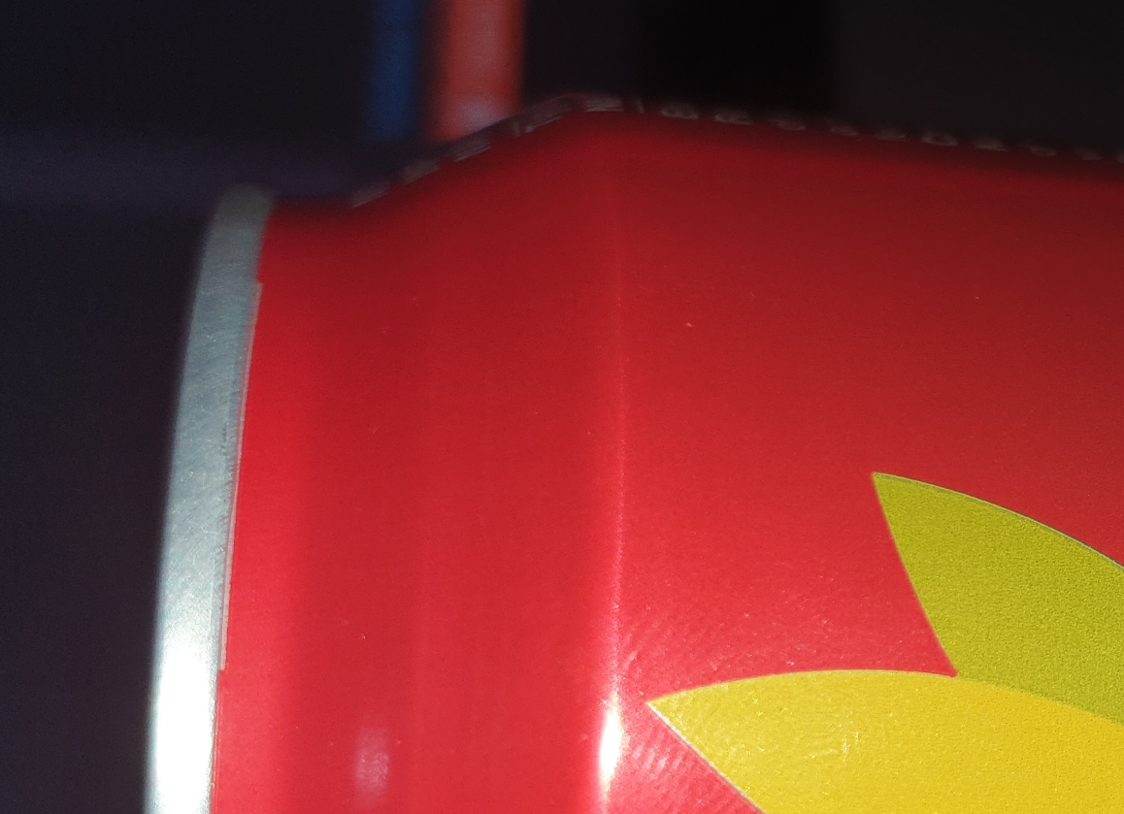
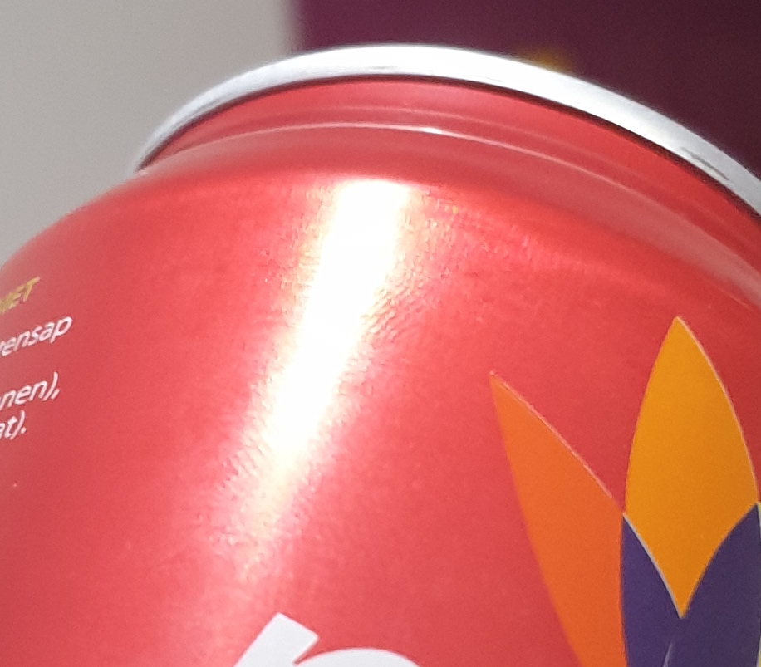
Qualitative Analysis
- (Phong)
Phong really doesn’t measure up to the shininess of metal, though this might be somewhat of and unfair comparison given the “in_Roughness” value isn’t equivalent to either the shininess or specular weight arguments the Phong shader takes its still doesn’t look great.

Slide 14
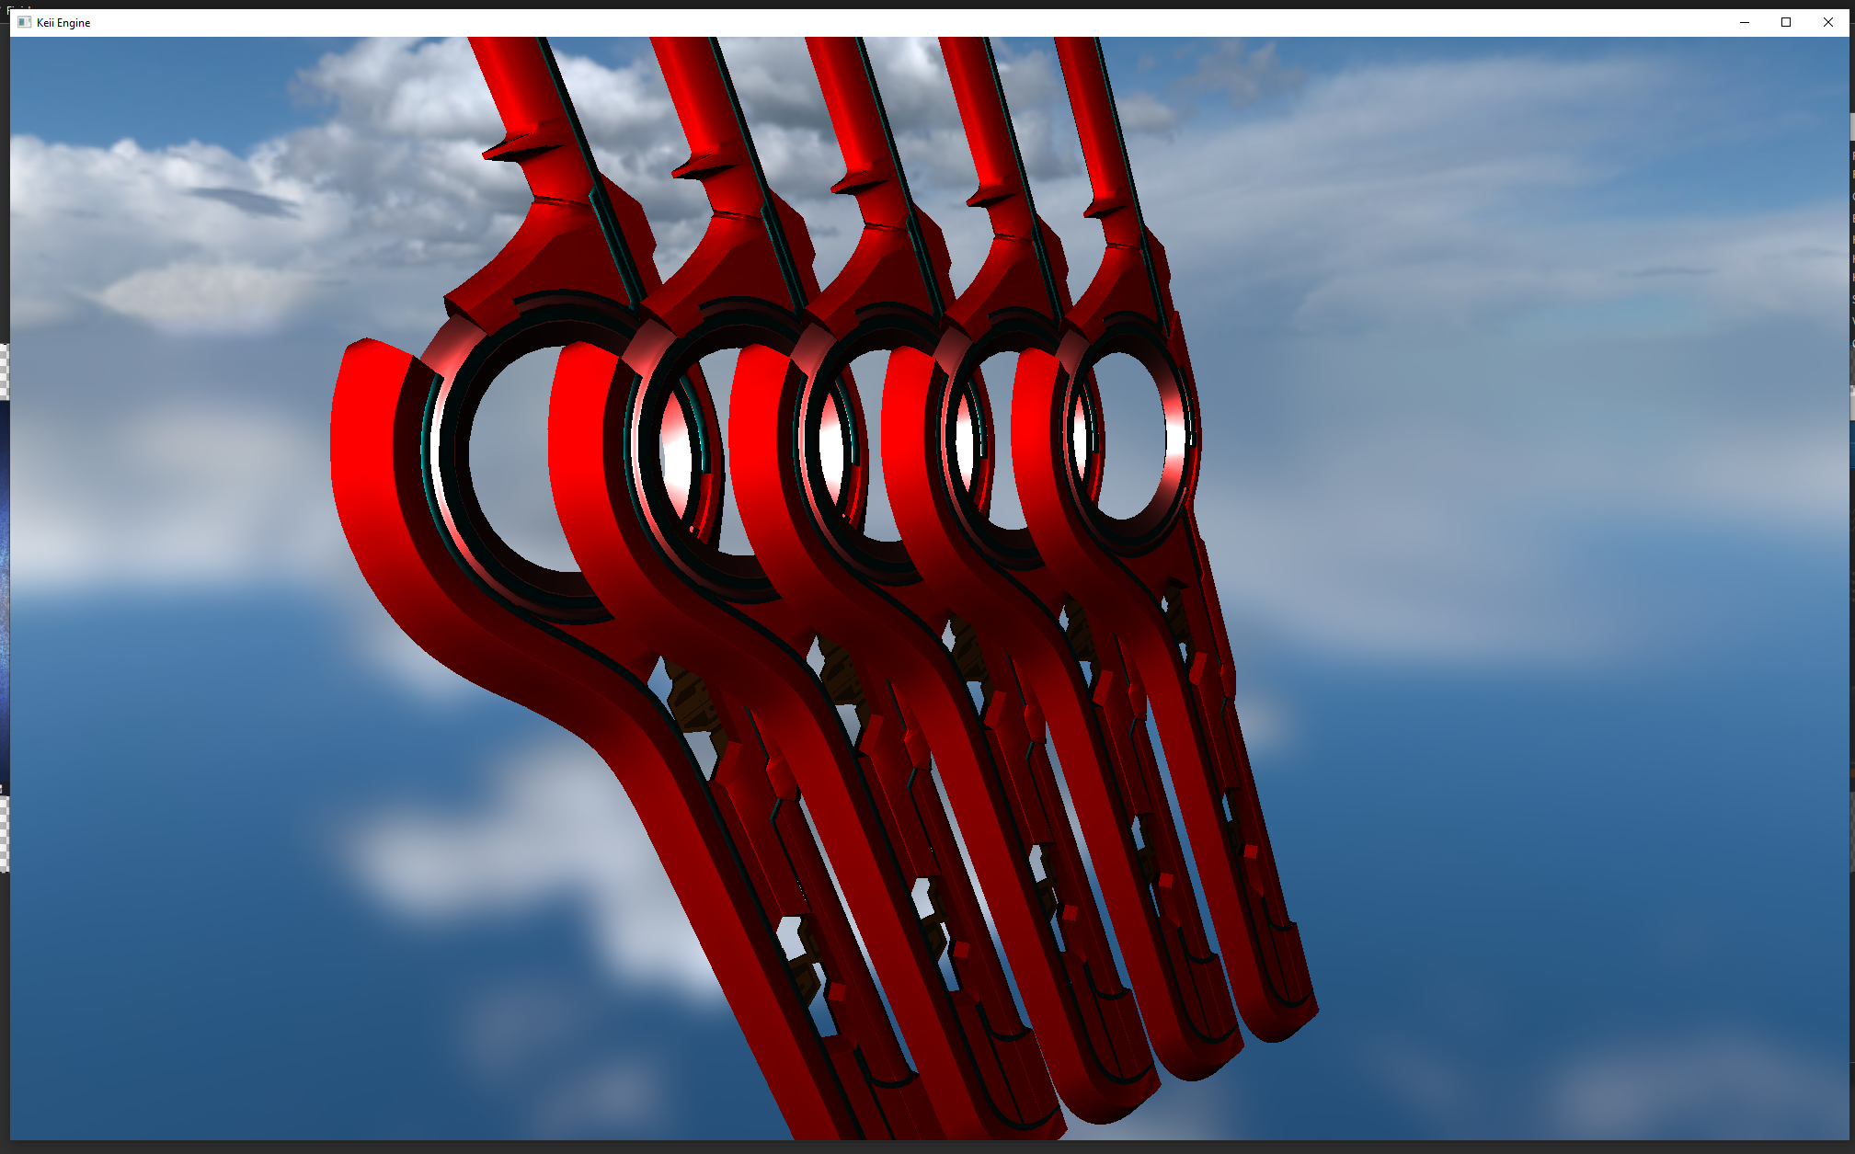
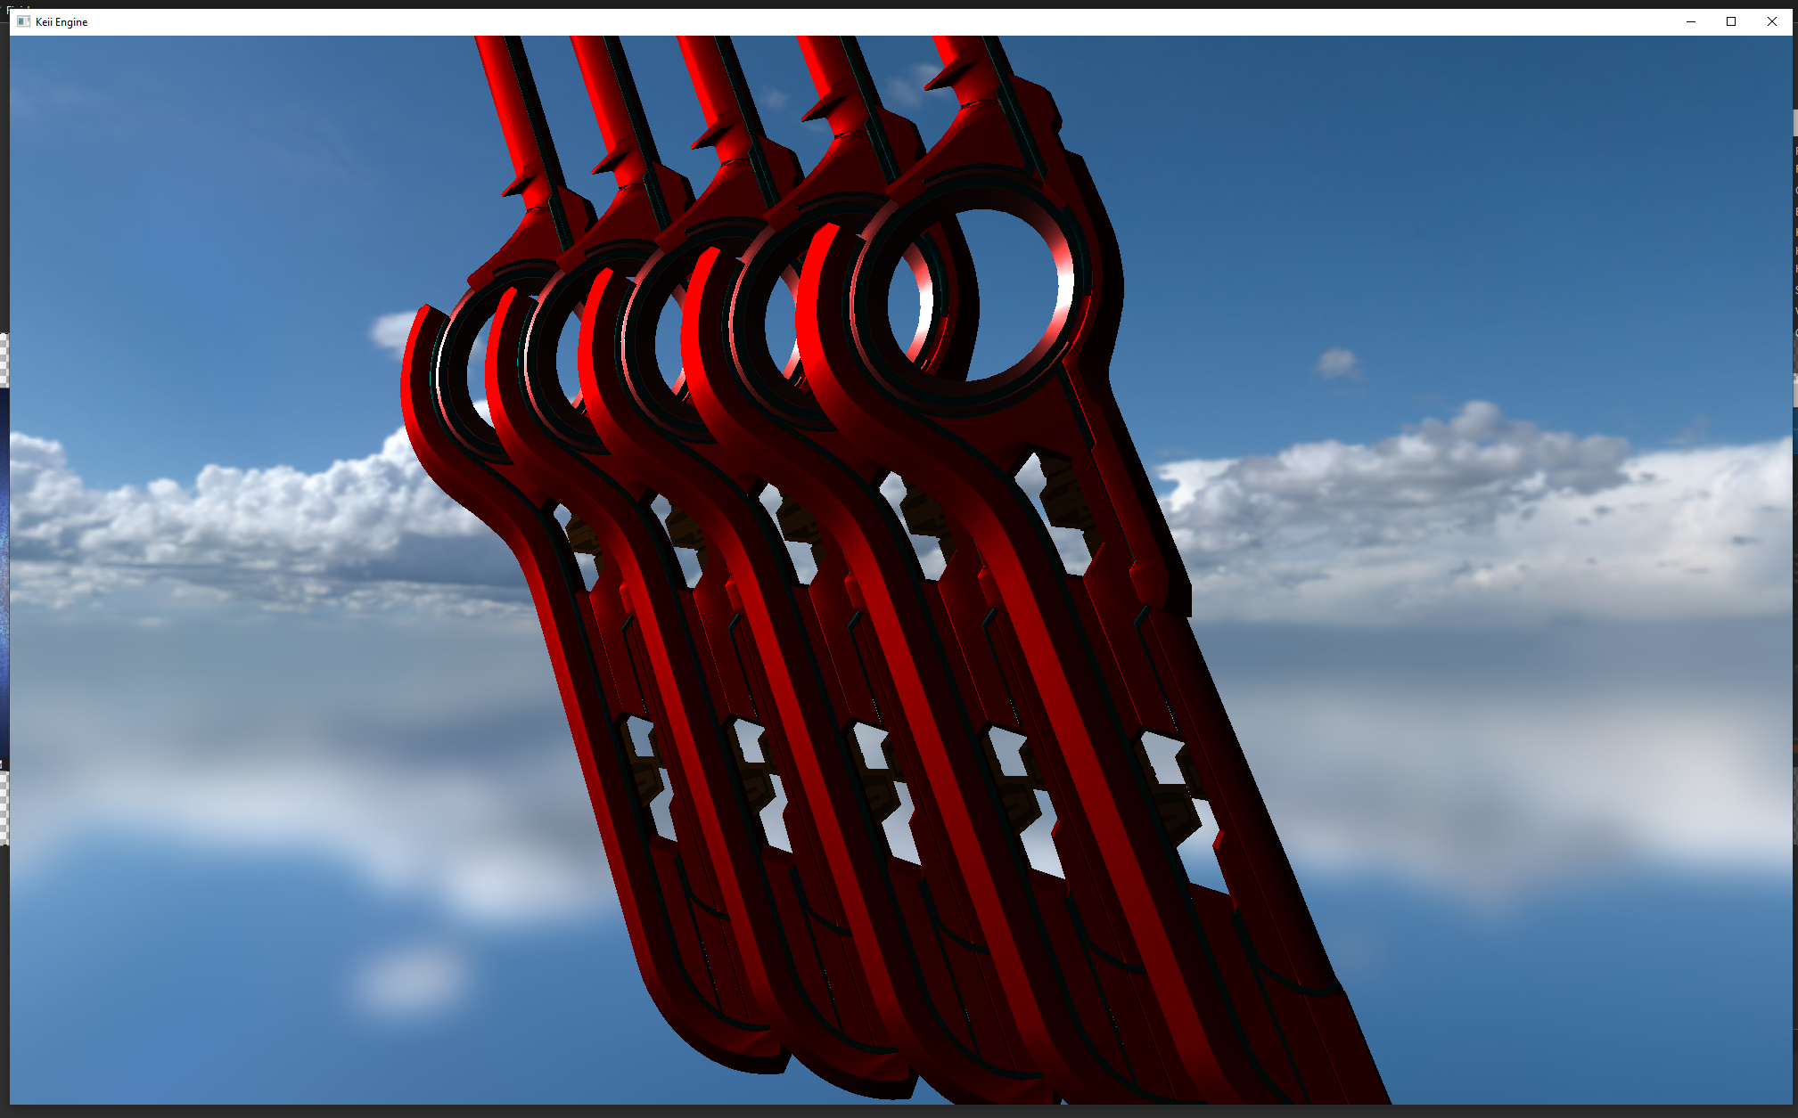
Qualitative Analysis
- (LearnOpenGL - PBR)
With the material set as metallic and the roughness set to 0.5, the LearnOpenGL PBR shader acts as a reasonably good equivalent for the replacement of the red can.

Slide 15

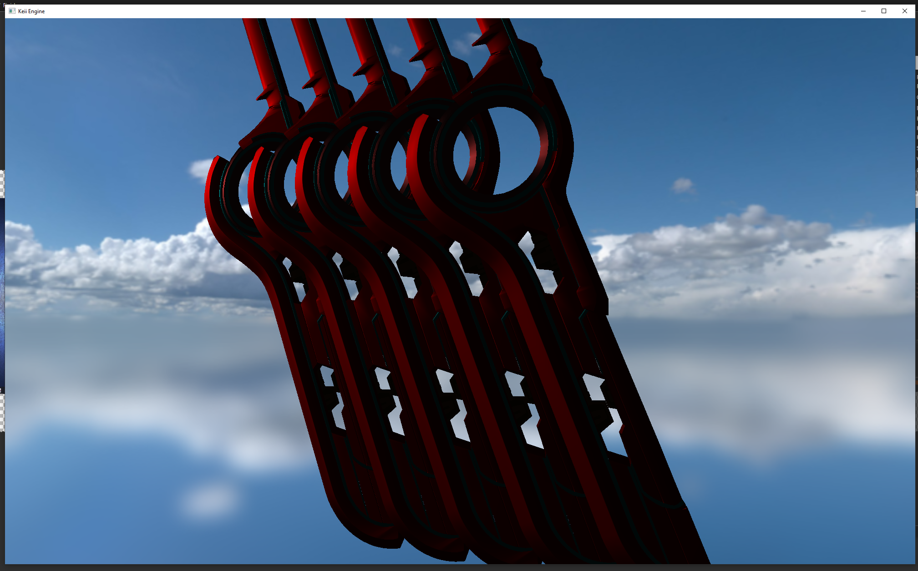
Qualitative Analysis
- (Torrance-Sparrow / Oren-Nayar)
The Torrance-Sparrow / Oren Nayar model shader doesn’t fair too poorly, but neither too well either. The shininess is lost a fair bit – especially at steeper angles looking towards the light source.

Slide 16
Conclusions
‘Performance’ wise the better shader appears to be the Phong shader. Ideally it would be worth testing with more lights in the scene, however without changing the code to accommodate for this the results stay as they are.
In terms of ‘Visual Quality’ however I believe the LearnOpenGL PBR shader works best, the colour is maintained in low light with high roughness a lot better then the Torrance-Sparrow model, while also having a much shiny appearance when either reflecting directly or from low viewing angles to the light source.
Overall the best overall would have to be the LearnOpenGL model. The performance differences seem almost negligible, and even when increasing the model count to over 100 and with 13 lights on top, the render cost didn’t seem to take much of an impact when comparing it to the others.
With that said though, unlike real life the reflections on top of the metal still are only affected by the colour base Albedo, ideally a reflection map should be used along side the correct integral calculation, rather then the loose unrealistic approximation used with the 2 PBR shaders tested above.

Slide 17
References
Learn OpenGL, 2016. PBR / Theory [online]. Available from: https://learnopengl.com/PBR/Theory [Accessed 16 December 2021]
Mimosa-Pudica. A tiny improvement of Oren-Nayar reflectance model [online]. Yasuhiro Fujii. Available from: https://mimosa-pudica.net/improved-oren-nayar.html [Accessed 16 December 2021]
Lombardi, S. Models of the Bidirectional Reflectance Distribution Function [online]. Drexel University. Available from: https://www.cs.drexel.edu/~david/Classes/CS431/Lectures/BRDF.pdf [Accessed 16 December 2021]
Heitz, E. Sampling the GGX Distribution of Visible Normals [online]. Unity. Available from: https://jcgt.org/published/0007/04/01/slides.pdf [Accessed 16 December 2021]
Meister, G. Wiemker, R. Monno, R. Spitzer, H. Strahler, A. 1998. Investigation on the Torrance-Sparrow Specular BRDF Model [online]. University Hamburg. Available from: https://www.researchgate.net/publication/3761219_Investigation_on_the_Torrance-Sparrow_specular_BRDF_model [Accessed 16 December 2021]
Oren, M. Nayar, S. Generalization of Lambert’s Reflectance Model [online]. Columbia University. Available from: https://www1.cs.columbia.edu/CAVE/publications/pdfs/Oren_SIGGRAPH94.pdf [Accessed 16 December 2021]

Slide 18
References
Walter, B. Marschner, S. Li, H. Torrance, K. 2007. Microfacet Models for Refraction through Rough Surfaces [online]. Cornell University. Available from: https://www.cs.cornell.edu/~srm/publications/EGSR07-btdf.pdf [Accessed 16 December 2021]
Heitz, E. 2018. Sampling the GGX Distribution of Visible Normals [online]. Unity. Available from: https://jcgt.org/published/0007/04/01/paper.pdf [Accessed 16 December 2021]
Torrance, K. Sparrow, E. 1967. Theory for Off-Specular Reflection From Roughened Surfaces* [online]. University of Minnesota. Available from: http://www.graphics.cornell.edu/~westin/pubs/TorranceSparrowJOSA1967.pdf [Accessed 16 December 2021]

